Slide 1

ATAL BIHARI VAJPAYEE VISHWAVIDYALAYA, BILASPUR (C.G.)
DEPARTMENT OF COMPUTER SCIENCE AND APPLICATION
SESSION=2025-26
Project Title : MAITRI 🩵AI Assistant for Psychological & Physical Well-Being
Guided by :-
Dr . Pallavi Singh
Presented By:-
Anshul Kushwaha
Sakshi Yadav

Slide 2
Project Overview – MAITRI
What is MAITRI?
MAITRI (Mental AI Therapeutic Response Interface) is an AI-powered mental health companion designed to understand human emotions and provide empathetic emotional support. It uses artificial intelligence and deep learning to detect a user’s emotional state through facial expressions, voice signals, and chat-based interaction, and then responds in a supportive and human-like manner using natural Hinglish language.
The goal of MAITRI is not to replace mental health professionals, but to act as a first-level emotional support system that helps users feel heard, understood, and emotionally supported anytime.
Why is this Project Important?
Mental health issues such as stress, anxiety, loneliness, and emotional fatigue are increasing rapidly, but:
Many people hesitate to openly talk about their feelings
Professional help is not always accessible or affordable
Traditional chatbots rely only on text and fail to understand real emotions

Slide 3
Project Overview – MAITRI
MAITRI addresses these challenges by:
Detecting emotions automatically, even when users don’t express them clearly
Providing 24/7 emotional support
Reducing stigma around mental health conversations
Creating a safe, non-judgmental space for emotional expression
By combining AI with emotional intelligence, MAITRI makes mental health support more accessible, personalized, and human-centric.

Slide 4
Project Overview – MAITRI
Key Features of MAITRI
1. Facial Emotion Detection
MAITRI analyzes real-time facial expressions using a webcam and a deep learning CNN model. It detects emotions such as happiness, sadness, anger, fear, surprise, and neutrality. Based on the detected emotion, MAITRI provides empathetic responses and supportive suggestions.
2. Voice Emotion Analysis
Through voice input, MAITRI analyzes speech tone, pitch, energy, and emotional patterns using a HuBERT-based deep learning model. This helps in identifying hidden emotions that may not be visible on the face or expressed in words.
3. Chat-Based Emotional Interaction
MAITRI includes an interactive chat and mood check-in system where users can describe their feelings. Using an advanced AI language model, MAITRI understands emotional context and generates comforting, motivational, and personalized responses in Hinglish.
Overall Vision By combining face, voice, and text-based emotion analysis, MAITRI offers a multimodal and intelligent approach to mental health support, making emotional assistance more natural, reliable, and accessible in everyday life.

Slide 5
PROBLEM STATEMENT
Mental health issues such as stress, anxiety, sadness, and emotional fatigue are increasing rapidly, but many people hesitate to openly express their feelings or seek professional help due to social stigma, lack of accessibility, or high costs. Existing mental health chatbots primarily rely on text-based interaction, which fails to accurately understand a user’s true emotional state.
Human emotions are often reflected through facial expressions and voice tone, not just words. The absence of multimodal emotion analysis leads to incomplete emotional understanding and less effective support.
Therefore, there is a need for an intelligent system that can automatically detect human emotions using facial expressions, voice signals, and conversational input, and provide empathetic, real-time, and accessible mental health support in a natural and user-friendly manner.

Slide 6
SOLUTION IDEA
The proposed solution, MAITRI (Mental AI Therapeutic Response Interface), is a smart mental health support system designed to understand and respond to human emotions using artificial intelligence and deep learning techniques. Instead of relying only on text input, MAITRI follows a multimodal approach by analyzing emotions through facial expressions, voice signals, and chat-based user interaction.
Facial emotions are detected using a Convolutional Neural Network (CNN), while voice emotions are analyzed using a HuBERT-based deep learning model that captures speech tone, pitch, and emotional patterns. In addition, the chat module allows users to express their feelings through a mood check-in form, which is processed by an AI language model to understand emotional context.
By combining emotional insights from all three modules, MAITRI generates empathetic, personalized, and real-time responses in natural Hinglish language. This solution aims to make mental health support accessible, user-friendly, and emotionally intelligent, helping users feel understood and supported without fear of judgment.

Slide 7
SYSTEM ARCHITECTURE
The system architecture of MAITRI is designed using a modular and layered approach, where each emotion detection component works independently while being integrated through a centralized backend. This architecture ensures scalability, flexibility, and efficient real-time processing.
At the frontend level, the user interacts with the system through a web-based interface built using HTML, CSS, and JavaScript. The interface allows users to provide input in three forms: webcam access for facial emotion detection, microphone access for voice emotion analysis, and a chat-based mood check-in form.
The backend layer, developed using Flask, handles user requests, routing, and communication between different modules. Each module processes its respective input:
The Face Emotion Module captures facial images and passes them to a CNN model for emotion prediction.
The Voice Emotion Module records audio input and analyzes it using a HuBERT-based deep learning model.
The Chat Module sends user mood data to an AI language model for emotional understanding.
The detected emotions from all modules are then processed to generate a context-aware and empathetic response, which is sent back to the frontend and displayed to the user in real time.
This modular architecture allows MAITRI to efficiently combine face, voice, and text-based emotion analysis, making the system robust, extensible, and suitable for real-world mental health support applications.

Slide 8
MAJOR MODULE DESCRIPTION
MAIN MODULES
1. Face Emotion Detection Module
Main Features
Real-time webcam-based facial emotion detection
Face ko detect karne ke liye OpenCV Haar Cascade use hota hai
CNN (Convolutional Neural Network) se emotion predict hota hai
7 emotions detect karta hai:
Happy
Sad
Angry
Fear
Disgust
Surprise
Neutral
Emotion ke according empathetic response generate karta hai
Fast aur lightweight hai, isliye real-time kaam karta hai
Dataset Used
FER2013 (Facial Expression Recognition 2013)
48×48 grayscale facial images
35,000+ images
Real-world facial expressions ke liye industry-standard dataset

Slide 9

MAIN MODULES
2. Voice Emotion Analysis Module
Main Features
Real-time voice recording (3–5 seconds)
Speech ke tone, pitch, energy aur speed ko analyze karta hai
HuBERT (Hidden-Unit BERT) deep learning model use karta hai
Background noise ke baad bhi emotion detect kar sakta hai
Voice se emotions detect karta hai even agar words clear na ho
Emotion ke basis par supportive Hinglish response deta hai
Dataset Used
Speech Emotion Recognition (en)TESS Dataset
Custom Hinglish Voice Samples
Total 7442 audio samples
16kHz sampling rate
7 emotional categories

Slide 10
MAJOR MODULE DESCRIPTION
MAIN MODULES
3. Chat / Mood Check-in Module
Main Features
Interactive mood check-in form
User se:
Current mood
Intensity level (1–10)
Duration of feeling
Sleep quality
AI Language Model (Google Gemini) emotional context samajhta hai
Personalized:
Emotional analysis
Motivation
Self-care suggestions
Natural Hinglish language for better emotional connection
Judgment-free aur human-like interaction
Dataset / Training
Pre-trained Google Gemini Large Language Model
Emotion understanding ke liye:
Large-scale conversational data
Human emotional text patterns
Project-specific emotional prompts se tuned (prompt engineering)

Slide 11
MODELS USED (CNN+HuBERT)- WHY & HOW
MAITRI uses deep learning models to accurately detect human emotions from both facial expressions and voice signals. Since facial data and audio data are fundamentally different in nature, two specialized models are used: CNN for images and Hubert for speech.
1. Convolutional Neural Network (CNN) for Facial Emotion Recognition
Why CNN is Used
Facial expressions are visual patterns formed by movements of facial muscles such as eyes, eyebrows, lips, and cheeks. CNNs are highly effective for image-based tasks because:
They automatically extract important spatial features from images
They can detect fine-grained facial movements (micro-expressions)
They are computationally efficient for real-time image processing
They outperform traditional machine learning models in image recognition tasks
Therefore, CNN is an ideal choice for detecting emotions from facial expressions.
How CNN Works in MAITRI
The webcam captures a real-time image of the user.
OpenCV is used to detect and crop the face region.
The cropped face image is resized to 48×48 grayscale format.
The image is passed through multiple convolution and pooling layers.
The CNN extracts facial features and classifies the image into one of the seven emotion categories.
The predicted emotion is sent to the backend for response generation.
Dataset Used: FER2013 Output: Facial emotion label (Happy, Sad, Angry, Fear, Disgust, Surprise, Neutral)

Slide 12
MODELS USED (CNN+HuBERT)- WHY & HOW
2. Hubert Model for Voice Emotion Recognition
Why HuBERT is Used
Human emotions are often reflected in voice characteristics such as tone, pitch, loudness, and speaking speed. Traditional audio features alone are not sufficient to capture emotional context. HuBERT (Hidden-Unit BERT) is used because:
It is a self-supervised speech representation model
It learns deep emotional and acoustic patterns from raw audio
It performs well even with noise and accent variations
It captures speech structure beyond simple sound features
This makes Hubert highly suitable for speech-based emotion recognition.
How Hubert Works in MAITRI
The system records the user’s voice input using a microphone.
The audio is sampled at 16kHz for consistency.
Acoustic features such as MFCCs, pitch, and energy are extracted.
The processed audio is passed to the fine-tuned HuBERT model.
Hubert analyzes speech representations and predicts the emotional state.
The detected emotion is forwarded for empathetic response generation.
Datasets Used: Speech Emotion Recognition (en)
, TESS, and custom Hinglish voice samples Output: Voice-based emotion classification

Slide 13
DATASET EXPLANATION
Dataset Explanation
Datasets play a crucial role in the performance and reliability of emotion recognition systems. In the MAITRI project, carefully selected and well-established datasets are used for training the facial and voice emotion recognition models to ensure accuracy, robustness, and real-world applicability.
1. Facial Emotion Dataset – FER2013
FER2013 (Facial Expression Recognition 2013) is a widely used benchmark dataset for facial emotion recognition tasks.
Dataset Details:
Total images: Approximately 35,000
Image resolution: 48 × 48 pixels
Image type: Grayscale
Emotion Classes: Happy, Sad, Angry, Fear, Disgust, Surprise, NeutralJustification for Use:
Contains real-world facial expressions with variations in lighting, pose, and facial structure
Low-resolution images help the model generalize better to real-time webcam inputs
Extensively used in academic research, making performance evaluation reliable
Usage in MAITRI: The dataset is used to train a CNN model to learn facial muscle movements and expression patterns, enabling accurate real-time facial emotion detection.

Slide 14
DATASET EXPLANATION
2. Voice Emotion Datasets – RAVDESS and TESS
To train the voice emotion recognition module, MAITRI uses multiple speech emotion datasets to improve model generalization and robustness.
A. RAVDESS Dataset
RAVDESS (Ryerson Audio-Visual Database of Emotional Speech and Song) is a high-quality, professionally recorded dataset.
Dataset Details:
24 professional actors (male and female)
Multiple emotional categories including happy, sad, angry, fearful, disgust, surprised, and neutral
Clean, studio-quality recordings
Justification for Use:
Provides balanced and clearly labeled emotional speech
Helps the model learn variations in pitch, tone, and intensity associated with different emotions
B. TESS Dataset
TESS (Toronto Emotional Speech Set) focuses on clear emotional articulation.
Dataset Details:
Emotion classes: happy, sad, angry, fear, disgust, surprise, and neutral
High clarity and consistency in speech samples
Justification for Use:
Enhances emotion classification accuracy
Strengthens the model’s ability to distinguish closely related emotions

Slide 15
DATASET EXPLANATION
2. Voice Emotion Datasets – RAVDESS and TESS
To train the voice emotion recognition module, MAITRI uses multiple speech emotion datasets to improve model generalization and robustness.
A. RAVDESS Dataset
RAVDESS (Ryerson Audio-Visual Database of Emotional Speech and Song) is a high-quality, professionally recorded dataset.
Dataset Details:
24 professional actors (male and female)
Multiple emotional categories including happy, sad, angry, fearful, disgust, surprised, and neutral
Clean, studio-quality recordings
Justification for Use:
Provides balanced and clearly labeled emotional speech
Helps the model learn variations in pitch, tone, and intensity associated with different emotions
B. TESS Dataset
TESS (Toronto Emotional Speech Set) focuses on clear emotional articulation.
Dataset Details:
Emotion classes: happy, sad, angry, fear, disgust, surprise, and neutral
High clarity and consistency in speech samples
Justification for Use:
Enhances emotion classification accuracy
Strengthens the model’s ability to distinguish closely related emotions

Slide 16
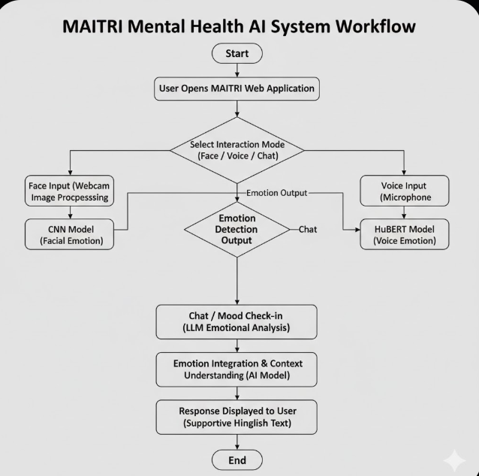
SYSTEM FLOW

Slide 17
SYSTEM FLOW
The user opens the MAITRI web application through a browser.
The system asks the user to select an interaction mode, which can be facial emotion detection, voice emotion analysis, or chat-based mood check-in.
If the face mode is selected, the system captures facial input using the webcam and processes the image.
The processed facial image is passed to a CNN model, which detects the user’s facial emotion.
If the voice mode is selected, the system records voice input using a microphone.
The recorded audio is analyzed using a HuBERT-based model to detect emotions from speech patterns.
The detected emotion from the face or voice module is generated as the emotion detection output.
The system then uses a chat or mood check-in module, where a large language model analyzes the emotional context of the user.
Emotional information from face, voice, and chat inputs is integrated to understand the user’s overall emotional state.
Based on the integrated emotional context, the AI system generates an empathetic and supportive response.
The response is displayed to the user in the form of supportive Hinglish text.
The process ends without storing any user data, ensuring privacy and security.

Slide 18
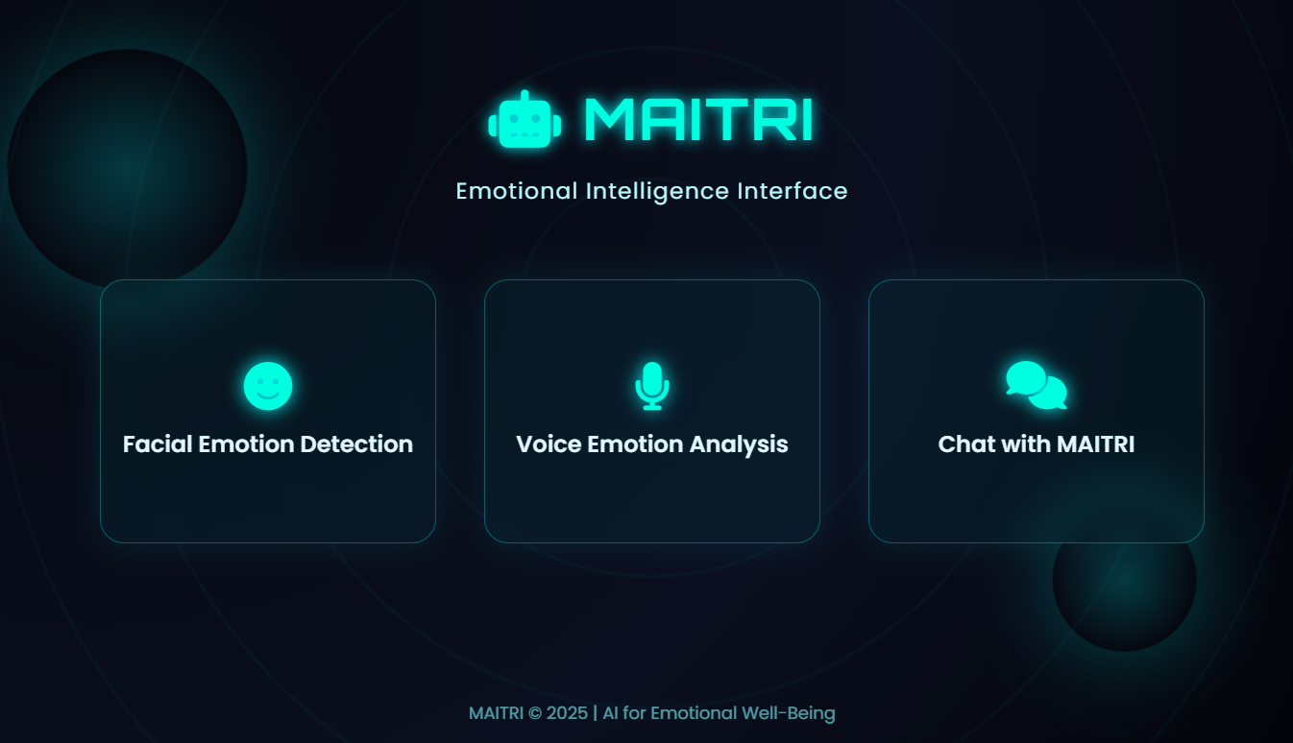
SYSTEM SCREENSHOTS

Slide 19
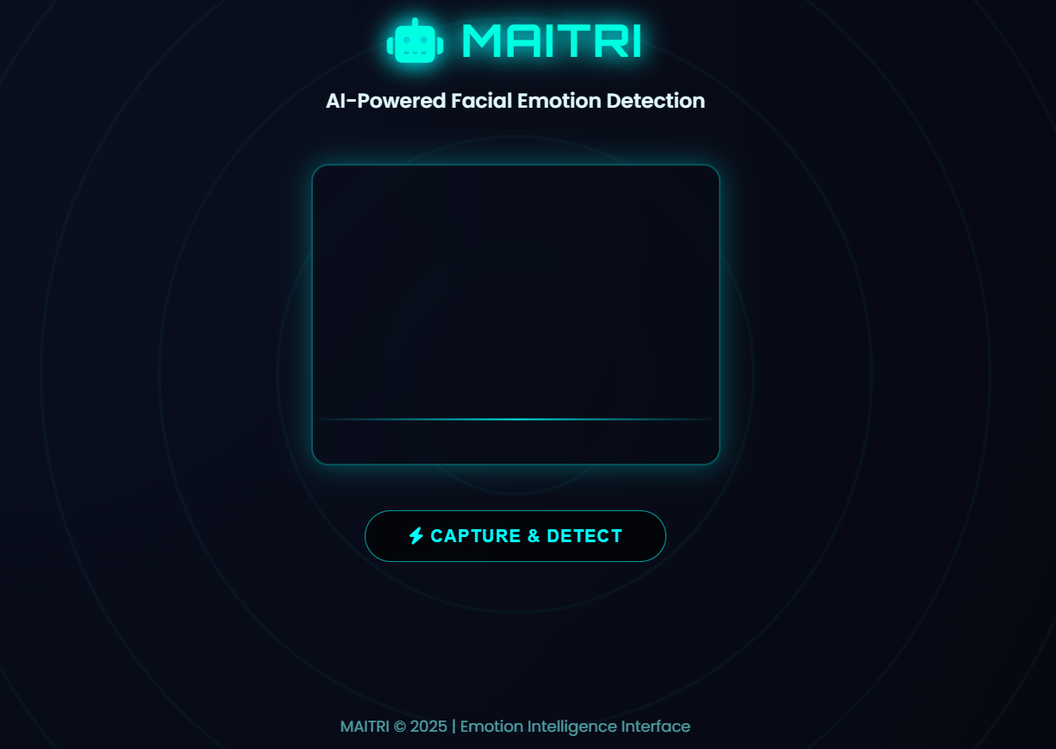
SYSTEM SCREENSHOTS

Slide 20
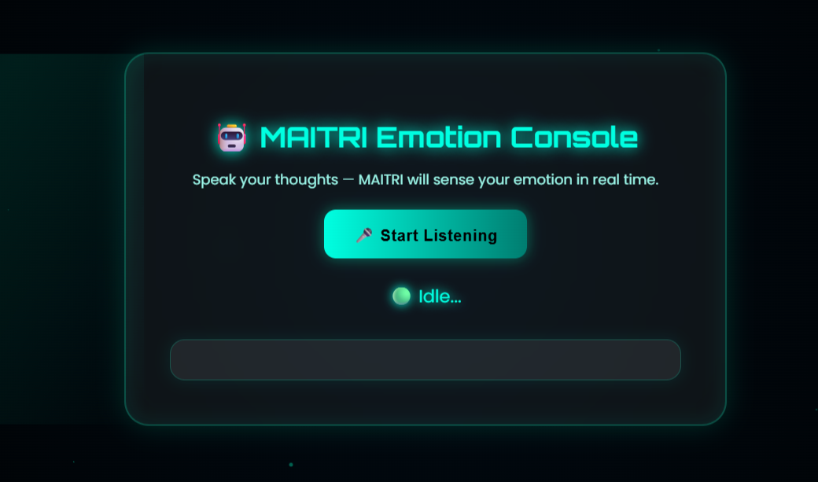
SYSTEM SCREENSHOTS

Slide 21
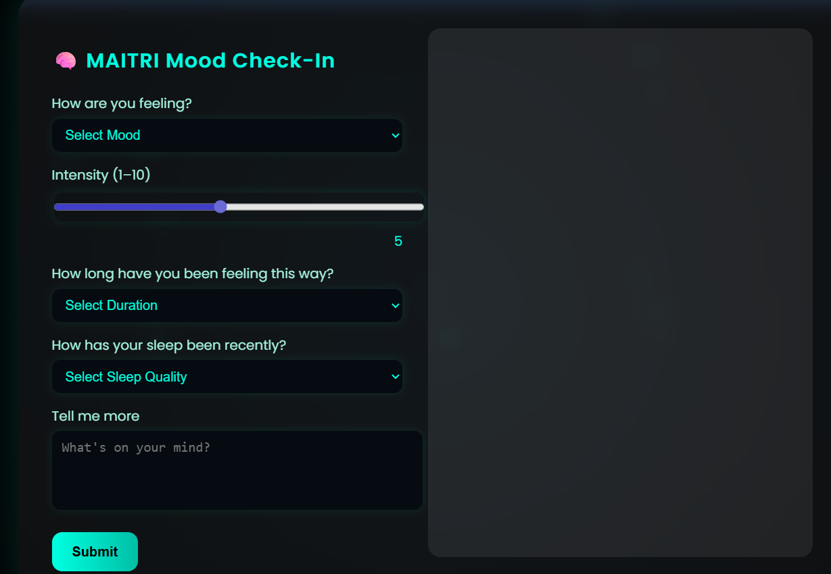
SYSTEM SCREENSHOTS

Slide 22
MAITRI is a multimodal AI-based mental health support system designed to understand and respond to human emotions in a natural and empathetic manner. By integrating facial emotion recognition using CNN, voice emotion analysis using HuBERT, and chat-based emotional understanding using a large language model, MAITRI provides a more accurate and human-like interpretation of a user’s emotional state.
The system successfully demonstrates how artificial intelligence can be used to make mental health support more accessible, personalized, and non-judgmental. Its modular architecture allows real-time emotion detection and response generation while maintaining user privacy by avoiding data storage.
Although MAITRI is not a replacement for professional mental health services, it serves as an effective first-level emotional support companion, especially for individuals who hesitate to openly express their feelings. Overall, the project highlights the potential of multimodal AI systems in addressing mental health challenges and lays a strong foundation for future enhancements in intelligent emotional support applications.
CONCLUSION

Slide 23
Thank You

